Slide 1
JAVASCRIPT COOKIES

Slide 2
JavaScript Cookies
A cookie is an amount of information that persists between a server-side and a client-side
A web browser stores this information at the time of browsing.
A cookie contains the information as a string generally in the form of a name-value pair separated by semi-colons.
It maintains the state of a user and remembers the user's information among all the web pages.

Slide 3
How Cookies Works?
When a user sends a request to the server, then each of that request is treated as a new request sent by the different user.
So, to recognize the old user, we need to add the cookie with the response from the server.
browser at the client-side
Now, whenever a user sends a request to the server, the cookie is added with that request automatically. Due to the cookie, the server recognizes the users.

Slide 4
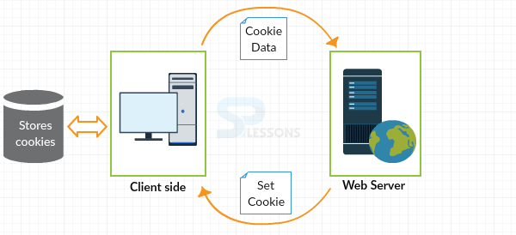

Slide 5

How to create a Cookie in JavaScript?
In JavaScript, we can create, read, update and delete a cookie by using document.cookie property

